Slide 1
Fraud Detection in Healthcare Insurance Claims
REVA Academy for Corporate Excellence (RACE)
Brajesh Kumar
SRN: R18DM060
Date: 20th August 2022
MBA in Business Analytics
Capstone Project Presentation
Year: I
race.reva.edu.in

Slide 2
Agenda
01
09
Descriptive Analytics
Introduction
05
Project Methodology
Conceptual Framework | Research Design
Univariate | Bivariate | Hypothesis
Back Ground | Current status | Why this study
10
Modeling
02
06
Literature Review
Business Understanding
Machine Learning | Model Evaluation | Insights
Seminal works | Summary | Research Gap
Business Context | Monetary Impact
11
Model Deployment
03
07
Data Understanding
Applications | Demo
Problem Statement
Business Problem | Analytics Solution
Data Collection | Variables
12
Suggestions and Conclusions
Insights | Next Step \| Future Scope
04
08
Data Preparation
Project Objectives
Primary & Secondary Objectives | Expected Outcome
Pre-processing | Process \| Techniques
13
Annexure
References | Publications | Plagiarism Score

Slide 3
Health Insurance Market
Cost of Frauds in Healthcare Insurance
Cost of Healthcare insurance
$49 Billion Insurance fraud spending in 2020 on healthcare
$700 Billion Insurance spending in 2020 on healthcare
7% of total insurance spend

Slide 4
Problem Statement
Business Problem | Analytics Solution
Percentage of medical professionals think that patients' fear of malpractice lawsuits is the primary driver of overtreatment.
Physicians believe their colleagues perform unnecessary procedures if it could profit them.
70%
85%
Analytics Solution:
Feature engineering on 360 features in the data set
Using ensemble models to classify the Medical fraud data
Models implemented in this study are LR, DT, SVC and NB

Slide 5
Project Objectives
Expected
To identify fraudulent claims
Outcome 1
Whether the claim is filed properly and with proper logical timelines.
Whether the claim has some high-risk scores in terms of patient chronic disease, high claim amount or any other.
Whether the provider or physician is usually relating to sending higher claims or services which are not needed for some kinds of diagnosis or issues.
Whether the provider or physician is located near any other fraud-related physician or provider.
Whether the fraud is based on an existing pattern or a new method of conducting fraud has been initiated by the beneficiary or related parties
Monitor the claims for anomalies.
Outcome 2

Slide 6
Project Methodology
Research Design
Data Consolidation
Logistic Regression, Decision Tree, SVC, and Gaussian Naïve Bayes Models and SMOTE oversampling ratios
Feature engineering using Random Forest.
Models run with various oversampling ratios after feature engineering.
Best model and output considered.

Slide 7
Business Understanding
Business Impact | Challenges | Monetary Impact
Business Impact:
The cost of fraud to beneficiaries, insurance companies and everyone else is very high. The biggest impact is that this increases the cost of healthcare services as well as insurance premiums, which further impacts everyone.
Challenges:
The fraudsters are able to replicate some known ways to defraud the insurance companies. They are also innovative enough to identify new ways every day to use fraudulent claims.
Monetary Impact:
The expense of insurance claims is increasing day by day. And at approx. 10% of that, the expense due to frauds is too high.

Slide 8
Data Understanding
Data Collection | Variables
Data Collection :
Considered data of around 5.5k providers, 138k beneficiaries, 5.5Lakhs claims records and all the claims for inpatient and outpatient for these providers together with more details of the beneficiaries has been captured in the insurance claim form.
Variables:
After combining the 4 tables and aggregating by provider ID, we get 360 variables.
Data Matrix
5.5k provider, 138k beneficiaries, 5.5 Lakhs claims records
After aggregation, 360 variables
After feature engineering, there are 161 variables with more than 0.1% feature importance.

Slide 9
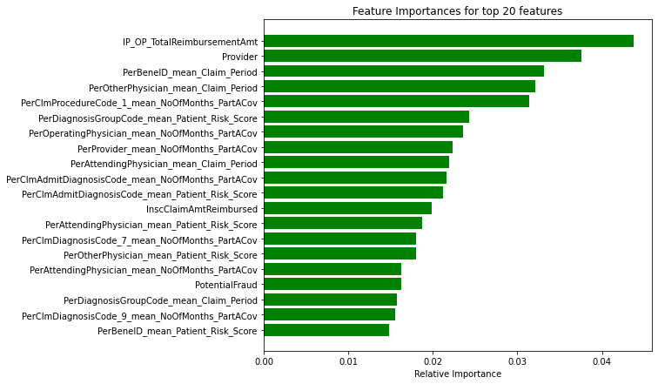
Data Understanding
Data Collection | Variables
Top 20 Features
Below are the features with the most impact to identify if the claim is fraud related:
Inpatient and outpatient total reimbursement
Provider ID
Per beneficiary mean of claim duration
Per other physician mean of claim duration
For procedure code 1, mean no of months in part A coverage
Per diagnosis type, mean of patient risk score
Per operating physician mean of no of months I part a coverage
Per attending physician’s mean of the claim period
Per claim admit diagnosis code mean of patient risk score

Slide 10
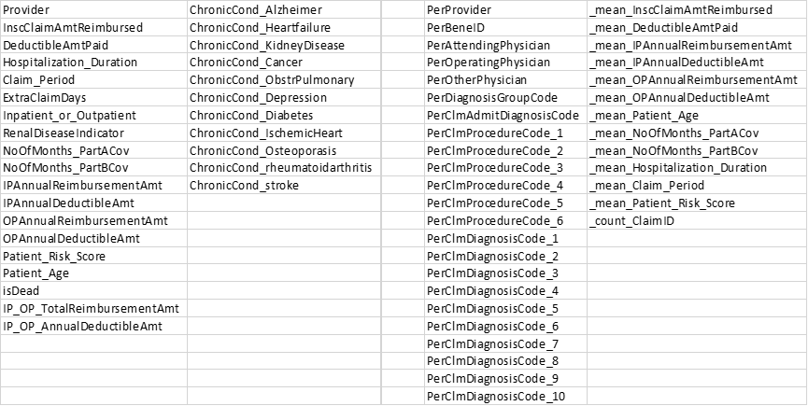
Data Preparation
Pre-processing | Techniques
Master Data model prepared after merging and aggregating.
Further aggregation below
Various info from beneficiaries or claims are aggregated directly by the provider

Slide 11
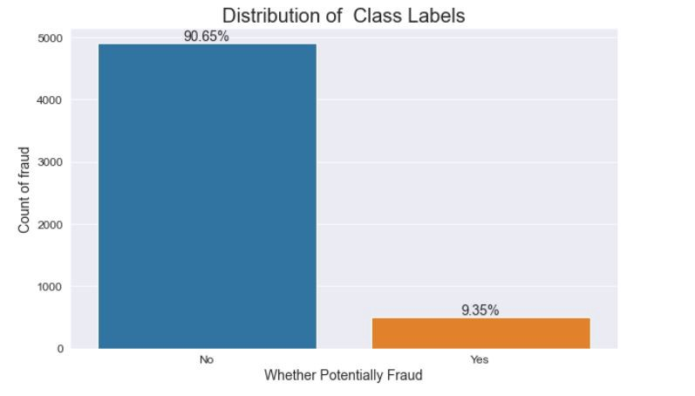
Descriptive Analytics
Multivariate Analysis
Distribution of Class Labels (Provider Data)
The claims data is unevenly distributed. 90% of providers are honest, compared to 10% fraudulent ones.

Slide 12
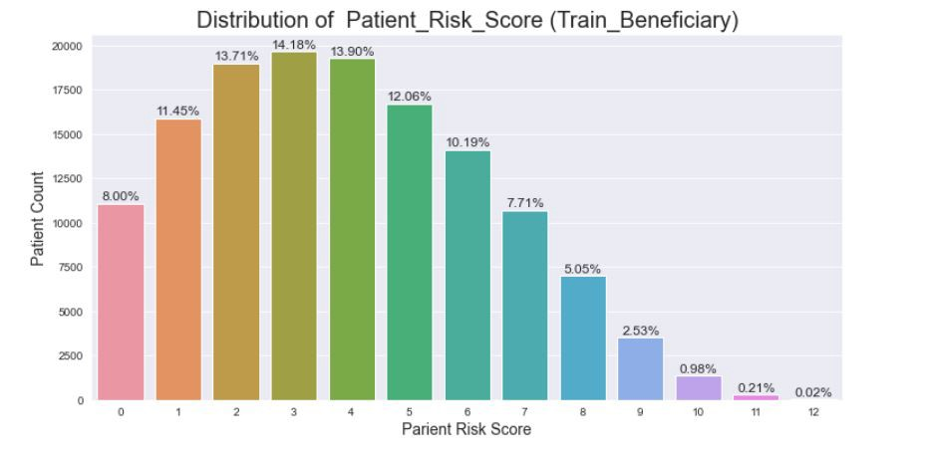
Descriptive Analytics
Multivariate Analysis | Hypothesis
Risk Score based on Patient Volume
The distribution of patient risk scores is highest between 2 to 5 and reduces after that. Patients with risk ratings of 9, 10, 11, and 12 are extremely scarce.

Slide 13
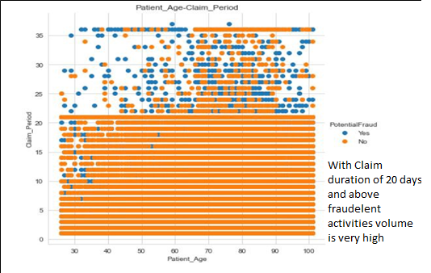
Descriptive Analytics
Multivariate Analysis | Hypothesis
Claim Period vs Patient Age
There is a greater likelihood that the transaction is fraudulent if the patient's age is mentioned correctly in years and the claim duration exceeds 20.

Slide 14
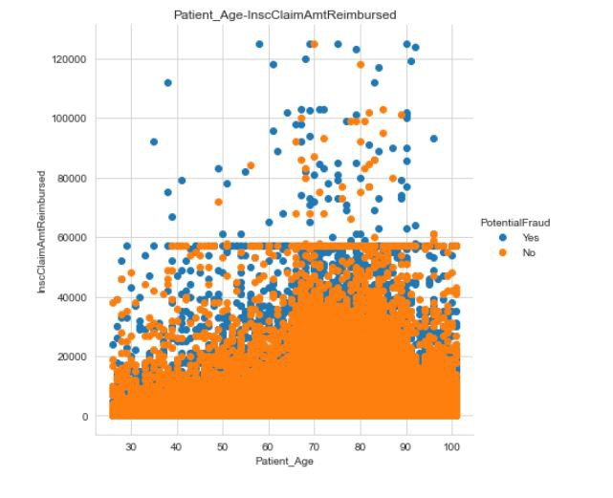
Descriptive Analytics
Multivariate Analysis | Hypothesis
Patient Age vs Insurance Claim Amt Reimbursed
There is a huge number of claims with a 60k amount, and many of them relate to frauds.
Further above 60k, the claims are fewer and many of the claims are fraud related.
Above 88 years of age, the fraud count is high.

Slide 15
Modeling
In this study, it is observed that the total features after EDA was 360, out of which, features with importance greater than 0.1% are 161 and features with importance less than 0.1% are 199.
The data was run against the models LR, DT, SVC, and NB over all 360 features, and then again with features with importance greater than 0.1%, against the models which are LR, DT, SVC, RF and NB.

Slide 16
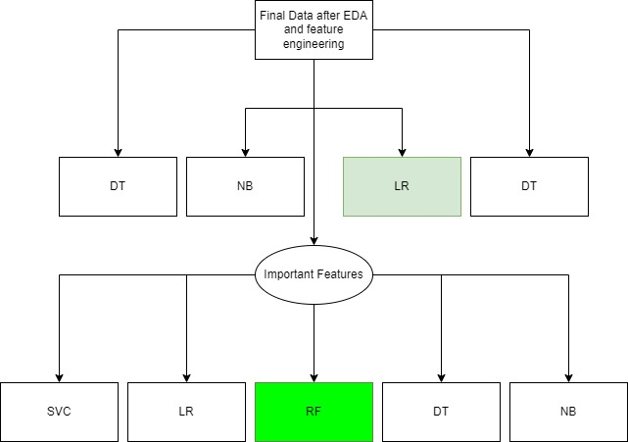
Modeling
In this study, LR, DT, SVC, and NV models were used with various sampling ratios of fraud vs non-fraud.
Then Feature selection was performed with RF to determine important variables. Out of 360 features, 161 had the importance of 0.1% and above.
Then LR, RF, DT, SVC, and NB models were used on important features with various sampling ratios to predict the Fraud and reduce the False Negative.

Slide 17
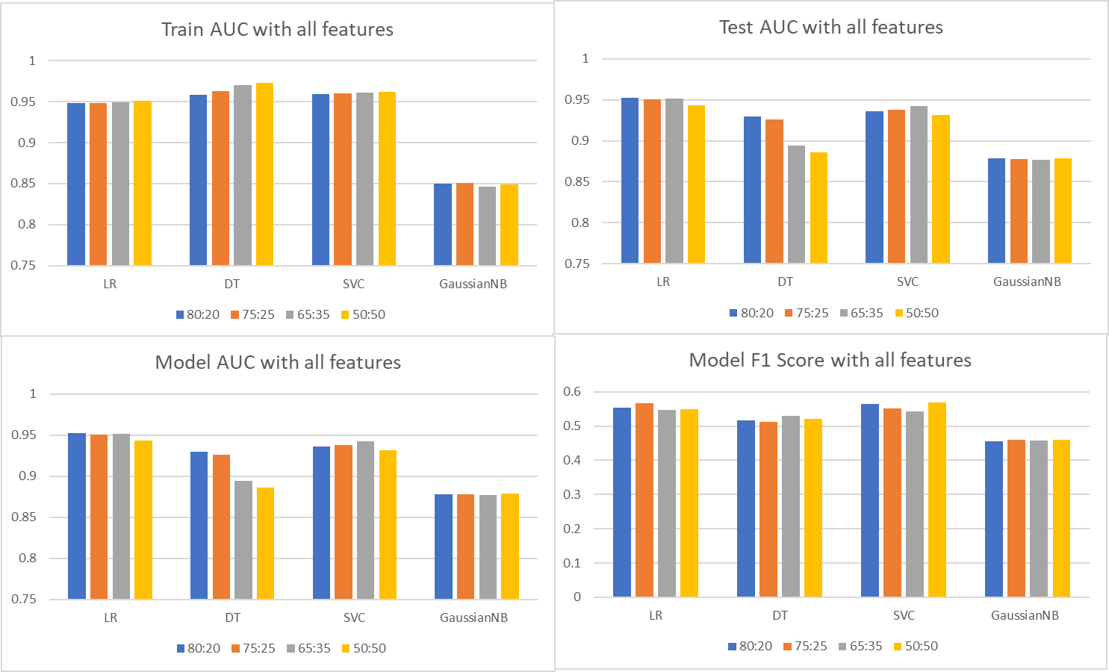
Model Evaluation
Results after running the models with all features
Over here 4 models were run, each with 4 different oversampling ratios.
For Train data, DT has the best AUC, while for Test data LR has the best AUC.
For further improvisation on the models, we checked feature engineering with RF.

Slide 18
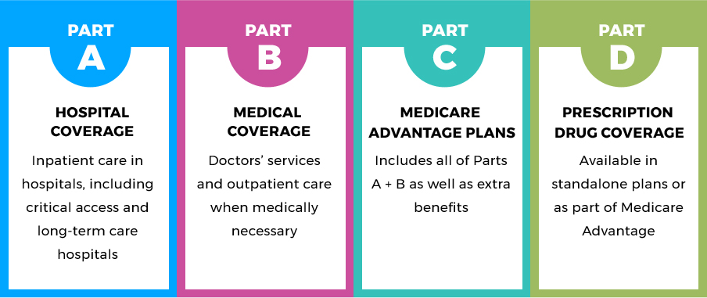
Model Evaluation
Part A and Part B coverage has been part of important features that have an impact on fraud detection.

Slide 19
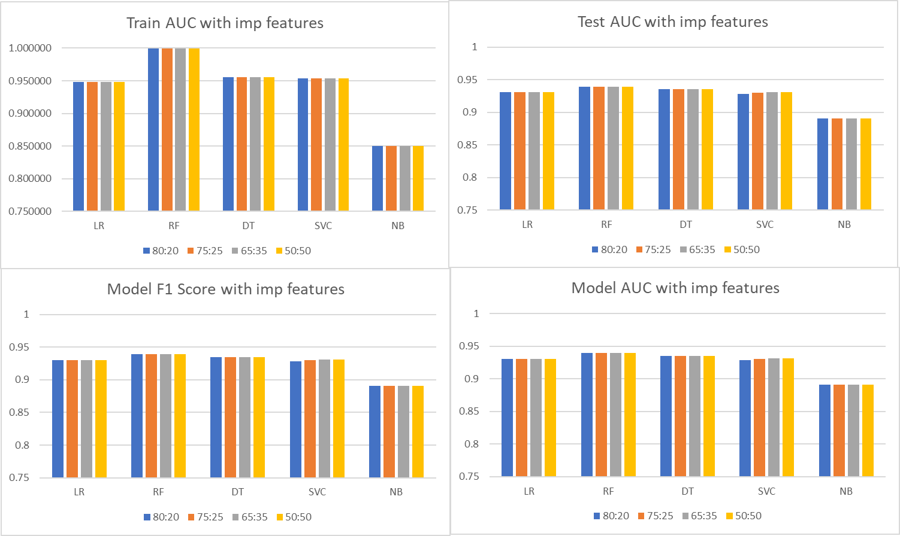
Model Evaluation
Results after running the models with important features
On observing the train AUC, we could see that it is highest for RF across all sampling ratios, and the accuracy is constant across all sampling ratios for any of the models.
On observing the test AUC, we could see that it is highest for RF across all sampling ratios, and the accuracy is constant across all sampling ratios for any of the models.

Slide 20
Model Evaluation
Interpretation | Important features
Below are a few features that have high feature importance:
Total Reimbursement amount.
Provider.
Per Beneficiary average of Claim Period.
Per Physician’s average of the claim period.
Per claim procedure 1 average no of months Part A coverage.
Per the Diagnosis code average patient risk score.
Per operating physician average of months in part A coverage.
Per provider mean in no of months of part A coverage.

Slide 21
Model Deployment
Demonstration
With offline and historic data, the solution is functioning with respectable quality. The system connecting to the web form and the ERP of different healthcare providers and insurance providers' claims systems could implement this approach. The model may request information to complete the claim along with more detailed inquiries that enable the model to assess if the claim is false. In cases where the risk of the patient, cost, provider, diagnosis, or procedure is low, this will enable us to approve the claims faster without requiring personal intervention. This enables the insurance provider to pay closer attention and focus on those cases where the risk appears to be significant.

Slide 22
Results and Insights
Suggestions
In this project, decreasing False Negative is more important than decreasing False Positive. And in this regard, the RF with important features has performed the best. It could be observed that RF has been able to significantly increase the performance on all quality parameters and also been able to keep the False Negative to the lowest across all models.

Slide 23
Conclusion and Future Work
Proposed solutions | Scope for future work
This study helps us to identify:
Whether the claim is filed properly and with proper logical timelines.
Whether the claim has some high-risk scores in terms of patient chronic disease, high claim amount or any other.
Whether the provider or physician is usually relating to sending higher claims or services which are not needed for some kinds of diagnosis or issues.
Whether the provider or physician is located near any other fraud-related physician or provider.
Whether the fraud is based on an existing pattern or a new method of conducting fraud has been initiated by the beneficiary or related parties.

Slide 24
References
Bibliography | Webliography
Görkem Gençer. (2022). 3 Ways AI is Changing the Health Insurance Sector. https://research.aimultiple.com/ai-health-insurance/
Thornton, D., van Capelleveen, G., Poel, M., van Hillegersberg, J., & Mueller, R. M. (2014). Outlier-based Health Insurance Fraud Detection for U.S. Medicaid Data. https://doi.org/10.5220/0004986106840694
Settipalli, L., & Gangadharan, G. R. (2021). Provider profiling and labeling of fraudulent health insurance claims using Weighted MultiTree. Journal of Ambient Intelligence and Humanized Computing. https://doi.org/10.1007/s12652-021-03481-6
Li, J., Huang, & K.-Y., Jin, J., & Shi, J. (2008). A survey on statistical methods for health care fraud detection. https://doi.org/10.1007/s10729-007-9045-4
Kanksha, Bhaskar, A., Pande, S., Malik, R., & Khamparia, A. (2021). An intelligent unsupervised technique for fraud detection in health care systems. Intelligent Decision Technologies, 15(1). https://doi.org/10.3233/IDT-200052

Slide 25
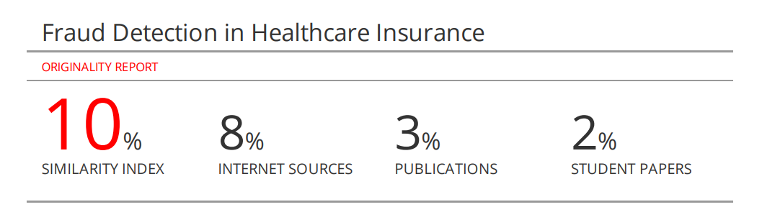
Annexure
Plagiarism score

Slide 26


